Slide 1
Colonization Patterns

Slide 2
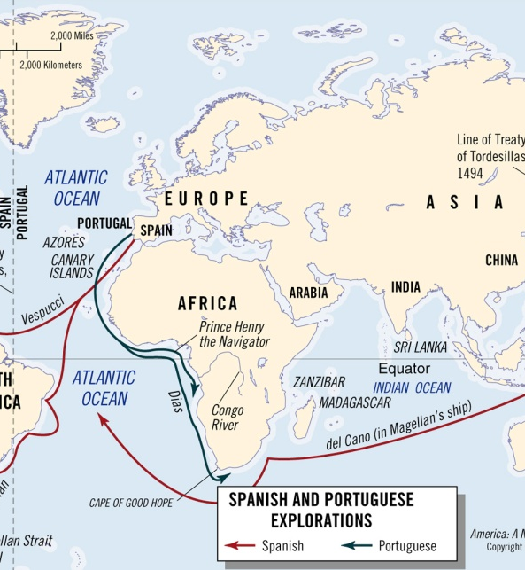
“Old World” Rehearsals
Portugal: Madeira (Wine Islands)
Exclusively imported labor
Spain: Canary Islands
Displace natives and import labor
England: Ireland
Privately-funded expeditions
Irish “savages”
Self-contained settlements (“plantations”)

Slide 3
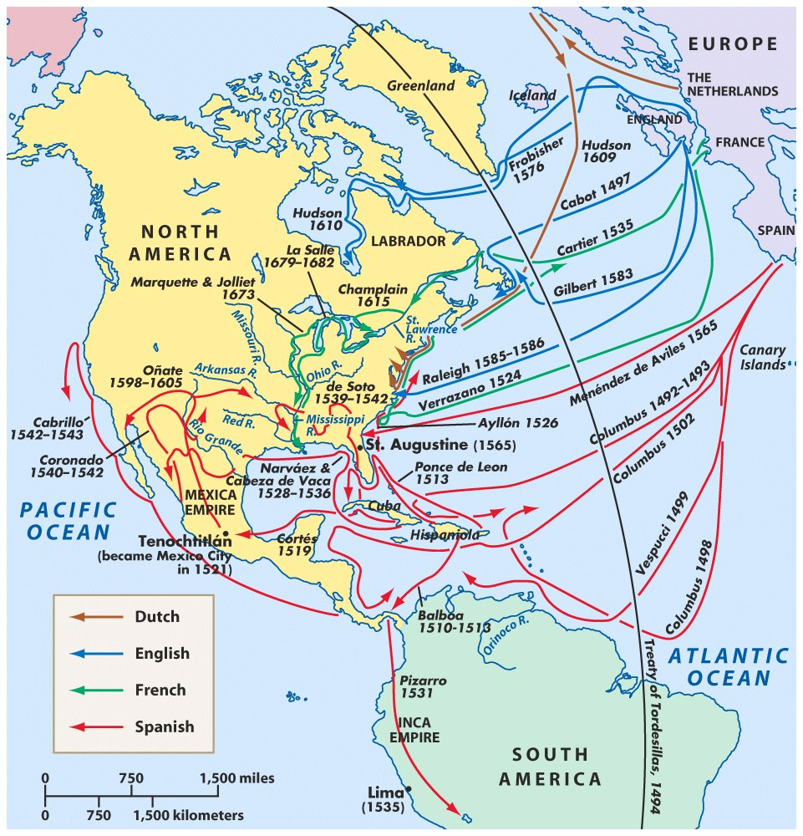
European colonization tendencies
Conquest: Spain
Trade: France, Netherlands
Settlement: England
(combination of all three elements)

Slide 4
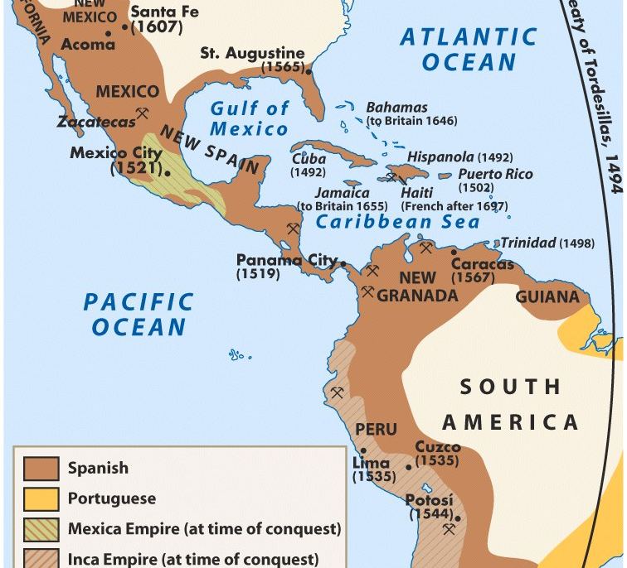
Spanish Conquest
Reconquista precedent
Large native populations
Allies
Cultural intermediaries
Labor
encomienda
Exportable wealth
Disease
Spanish missions and military buffers

Slide 5
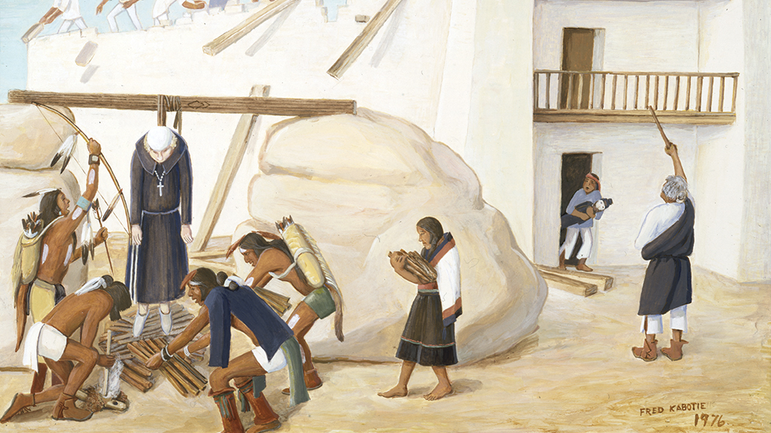
Pueblo Revolt

Slide 6
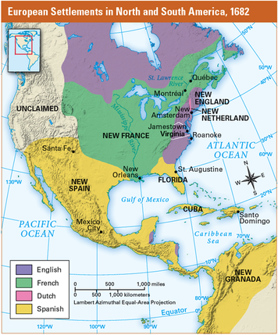
Why settle North America?
God
Greed
Glory

Slide 7

Key ideas:
Hot Commodities
Beaver pelts
Middle Ground
Changes in the landscape
Mediums of exchange
Wampum
Guns
Alcohol

